Slide 1
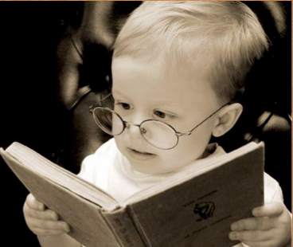
Language for literacy: Preparing our children for 3rd grade reading
National Smart Start Conference
Greensboro, NC
May 7, 2014
Kathy Hirsh-Pasek, Ph.D.
Temple University

Slide 2
A riddle for policy makers
What does the 30-million word gap have to do with the 3rd grade reading guarantee?

Slide 3
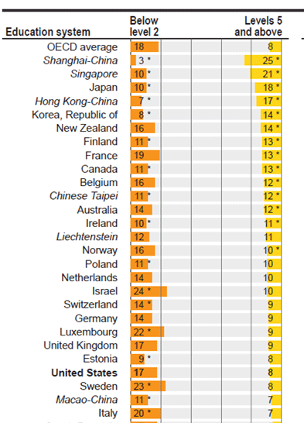
OR….Why did US kids still look terrible on the PISA scores released this year?
24th in line….

Slide 4
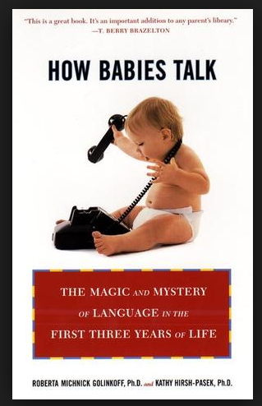
The answer in this presentation??
Reading performance depends on strong early language development! And many of our children start out with poor language skills.

Slide 5
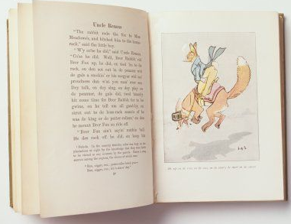
Reading is complex
One second in the mind of a reader
From processing visual print
To decoding sights to sounds (B-O-Y = boy)
To infusing text with meaning

Slide 6
In Scarborough’s terms

Slide 7
We know a tremendous amount about the word recognition or “code” skills
And they are critical for learning to read

Slide 8
But code skills are not enough!
Hebrew
Greek
You have to translate print into meaning!

Slide 9
And we know much less about how to support language for reading

Slide 10
A Talk in 3 parts
Language is a critical foundation for reading
6 Evidence-based principles of language learning that support reading
Implications and Policy recommendations

Slide 11
A Talk in 3 parts
Language is a critical foundation for reading
6 Evidence-based principles of language learning that support reading
Implications and Policy recommendations

Slide 12
The Evidence
Early language abilities are directly related to later reading abilities
Direct effects (NICHD ECCRN, 2002; Dickinson & Tabors, 2001)
1137 diverse sample from 3 years to 1st and 3rd grade
Lee, 2011 (N=1073; early language relates to language and reading achievement up to 5th grade)
Grissmer, 2011 (language and attention in K predict 4th grade reading better than does reading at K)
Early language abilities are indirectly related to reading through code skills like phonemic awareness; to finding the “b-sound” in “boy.” These code skills are then related to reading. ( Munson et al; 2004,2005; Storkel, 2001, 2003; Whitehurst &Lonigan, 1998, 2001; Silven et al., 2007)
Indirect effects (Storch& Whitehurst, 2002)
626 low-income children, 4 yrs to 4th grade
Language skills become relatively more important than code skills for reading over time. The shift from learning to read to reading to learn. (Storch& Whitehurst, 2002; Catts et al., 2006; Vellutino et al, 2007).

Slide 13
More recently…
Reviews of the relationship between language and reading show a persistent, strong and significant role of early language on reading…
Harris, Golinkoff and Hirsh-Pasek, 2011
See Marulis&Neuman, 2011 for a review

Slide 14
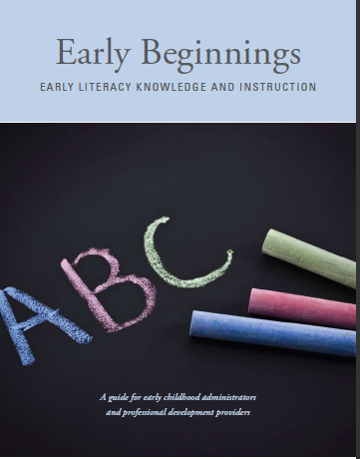
Despite these facts,
Most instruction in early school and most of our policy recommendations are focused on code skills rather than on the language skills that support reading.
Goodson, Layzer, Simon, & Dwyer,2009

Slide 15
And for low income children this can have dire consequences
”learning minority” learners who entered kindergarten with limited English proficiency had large persistent deficiencies in English reading achievement…Even the students who acquired English most rapidly, in the course of a year of kindergarten, continued to lag behind the national average for native English speakers by more than .33 standard deviation in 3rd and 5th grade.
p. 865, Kieffer, 2008

Slide 16
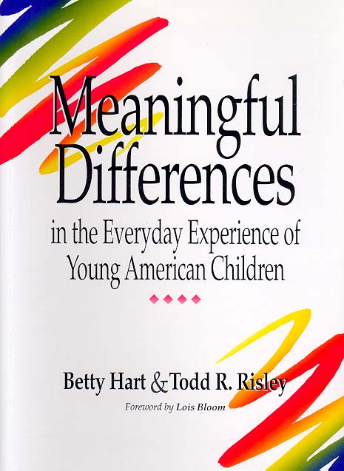
1995: Hart and Risley
Examines language input to children from…
Welfare
Working class
Professional families
(see also Hoff, 2002, 2003, 2013;Rowe et al., 2013; Pancsofar& Vernon-Feagans, 2010)

Slide 17
Results?
Number of words heard per hour by children in each group:
Welfare - 616
Working Class -1, 251
Professional - 2,153

Slide 18
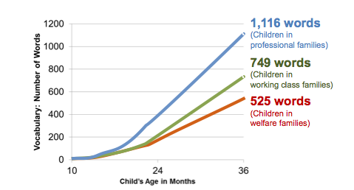
Significance?
Children’s vocabulary scores reflect the achievement gap by age 3!
Vocabulary assessed at age 3 predicted PPVT scores at age 9-10 (r = .58) and TOLD (more comprehensive) r = .72
Vocabulary at age 3 correlated with reading comprehension scores on
Comprehensive Test of Basic Skills r = .56
By second grade middle class children have 6000 root words; lower income 4000 -- 2 grade levels behind (E. Dale & O’Rourke, 1981)

Slide 19
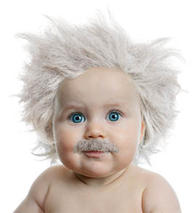
1996: Saffran, Aslin& Newport
The amount of language you hear matters because babies do statistical learning on the input they hear to find patterns of sounds and words!

Slide 20
2009: Fernald finds
That the amount of language a child hears also affects processing speed and hence later acquisition of vocabulary – findings that hold in English and Spanish.
Gaps in the amount that children hear and in the processing speed are evident as early as 9 months of age
And early vocabulary is one of the best predictors of later reading ability!
See also Weisleder and Fernald, 2013

Slide 21
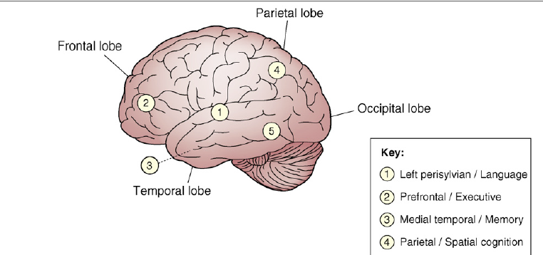
2010: Hackman& Farah
SES is an important predictor of neuro-cognitive performance, particularly of language and executive function, and that SES differences are found in neural processing even when performance levels are equal.
See also Raizada et al., 2008:
These findings suggest that the weaker language skills of low-SES children are related to reduced underlying neural specialisation, and that these neural problems go beyond what is revealed by behavioural tests alone. (p. 1392)
And Kuhl, 2013 (White House Conference) for additional evidence in early brain growth

Slide 22
These findings are particularly important for those learning English as a second language
As lower SES families, they will have depressed input even in their first language
Spanish speaking low-income parents are unlikely to offer much input at all in their new “foreign” language
Among English Language Learning children:
65.9% - lower-income households
40.8% come from families with less than a
high-school degree

Slide 23
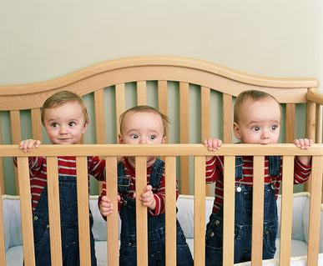
If reading is parasitic on language and not just on decoding, the question before us is how we can strengthen the language outcomes that children will need for reading

Slide 24
A Talk in 3 parts
Language is a critical foundation for reading
6 Evidence-based principles of language learning that support reading
Implications and Policy recommendations

Slide 25
Distilling from the literature, we boldly (or was that tentatively) suggest 6 principles of language learning that can be used to enhance language outcomes and the foundation for reading

Slide 26
The 6 principles
Children learn what they hear most-- frequency matters
Children learn words for things and events that interest them
Interactive and responsive environments build language learning
Children learn best in meaningful contexts
Children need to hear diverse examples of words and language structures
Vocabulary and grammatical development are reciprocal processes

Slide 27
1. Children learn what they hear most-- frequency matters
Hart &Risley (1995)
Amount of speech is important for statistical learning (Saffran et al., 1996)
Amount of speech is important for speed of processing (Fernald, 2009; Weisleder& Fernald, 2013)

Slide 28
A closer look at Fernald (2009): Amount matters because it increases processing speed!
Enter “looking while listening”

Slide 29
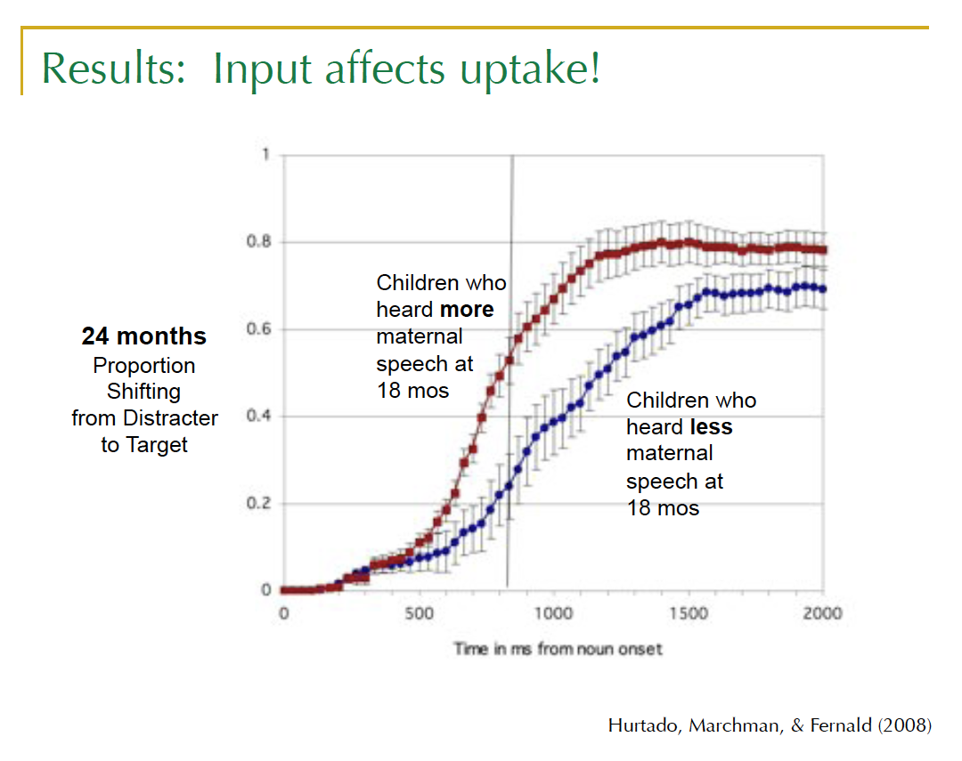
The amount of input also affects processing efficiency!

Slide 30
The 6 principles
Children learn what they hear most
Children learn words for things and events that interest them
Interactive and Responsive environments build language learning
Children learn best in meaningful contexts
Children need to hear diverse examples of words and language structures
Vocabulary and grammatical development are reciprocal processes

Slide 31
The evidence? Children learn words for things and events that interest them
L. Bloom’s Principle of Relevance
“Language learning is enhanced when the words a child hears bear upon and are pertinent to the objects of engagement, interest and feelings…” (p.19)
Babies attach labels to interesting not boring objects
Pruden, Hirsh-Pasek, Golinkoff&Hennon, 2006
Evidence from babies and toddlers in joint attention: talk about what baby is looking at and examining and baby is more likely to learn a word than if you try and change the child’s focus of attention
Akhtar, Dunham & Dunham, 1991; Tomasello& Farrar, 1986

Slide 32
Introducing the 6 principles
Children learn what they hear most
Children learn words for things and events that interest them
Interactive and responsive environments build language learning
Children learn best in meaningful contexts
Children need to hear diverse examples of words and language structures
Vocabulary and grammatical development are reciprocal processes

Slide 33
The evidence: Interactive and responsive environments build language learning
What counts as sensitive and responsive language?
Talking with not talking at
Expanding on what the child says and does
Noticing what the child finds interesting and commenting
Asking questions rather than just making demands

Slide 34
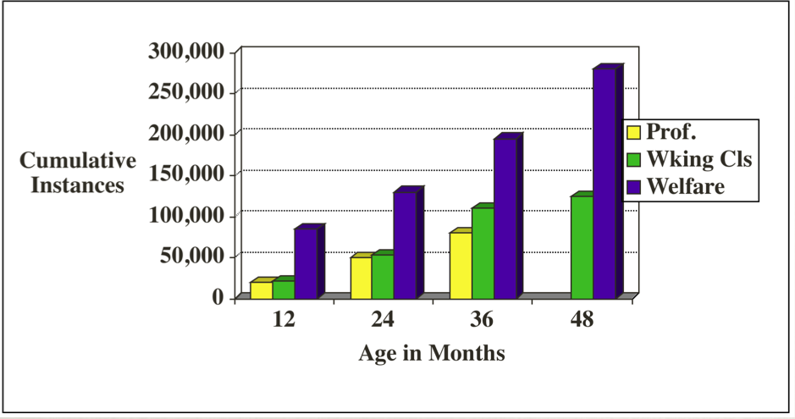
Encouragements (Affirmatives, praising)
Evidence 1: Back to Hart and Risley
Discouragements
(Prohibitions, negative evaluations)
There is wide variability in the sensitivity and responsivity
parents show to child language

Slide 35
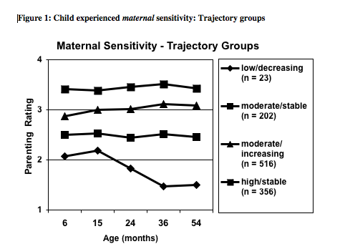
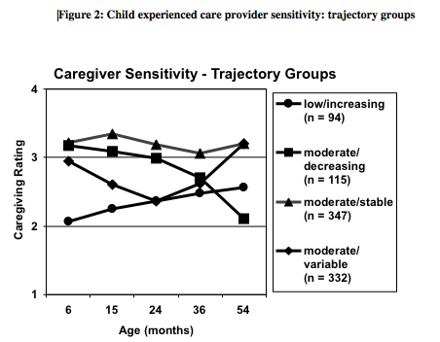
Evidence 2: Focus on Hirsh-Pasek &Burchinal (2005) using the NICHD ECCRN Data Base
The type of sensitivity pattern children experienced over time related to 54 month outcomes in language and in academic achievement (e.g. reading).

Slide 36
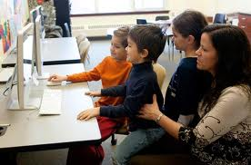
Evidence 3: Video chats vs TV Roseberry, Hirsh-Pasek and Golinkoff, 2013
Tested word learning from 24- to 30-month-olds in one of three ways:
Video Chat Training (responsive and contingent but 2D)
Live Interaction Training (responsive and contingent 3D)
Yoked Video Training (a pre-recorded video not responsive or contingent)

Slide 37
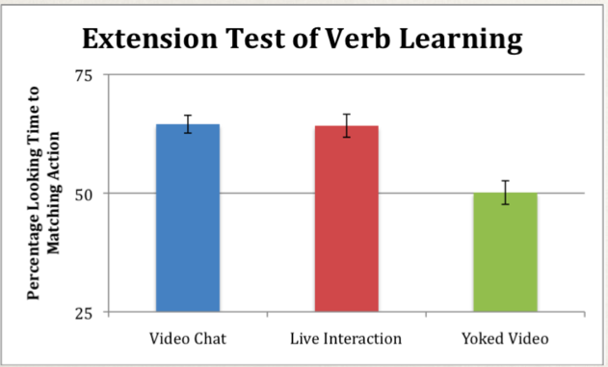
Results – How did children respond to video chats compared to live interactions?
Learning from video chats was more like LIVE than like TV

Slide 38
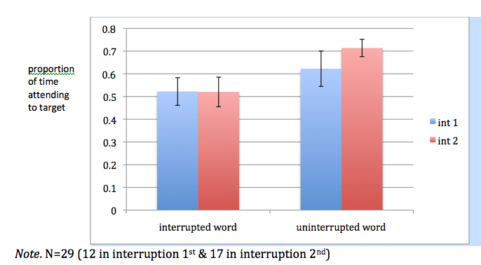
Example 4: The cell phone study And what happens to word learning when we BREAK the interaction?
Reed, Hirsh-Pasek &Golinkoff, 2013

Slide 39
The 6 principles
Children learn what they hear most
Children learn words for things and events that interest them
Interactive and responsive environments build language learning
Children learn best in meaningful contexts
Children need to hear diverse examples of words and language structures
Vocabulary and grammatical development are reciprocal processes

Slide 40
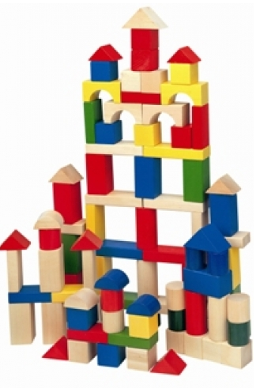
The evidence: Children learn best in meaningful contexts
Recent studies from our lab suggest that children learn richer vocabulary in playful learning where the information is meaningful than they do in direct instruction methods devoid of meaningful engagement.
This has been found in…
Studies on shape learning with 4-year-olds
Fisher, Hirsh-Pasek, Newcombe&Golinkoff, in press
Spatial language through block play with 4-year-olds
Ferrara, Shallcross, Hirsh-Pasek, Newcombe&Golinkoff, 2011

Slide 41
The 6 principles
Children learn what they hear most
Children learn words for things and events that interest them
Interactive and responsive environments build language learning
Children learn best in meaningful contexts
Children need to hear diverse examples of words and language structures
Vocabulary and grammatical development are reciprocal processes

Slide 42
The Evidence: Children need to hear diverse examples of words and language structures
Amount and diversity of verbal stimulation fosters early and rich language outcomes
Beebe, Jaffee&Lachman, 1992, Snow, 1986. Tamis-LeMonda& Song, 2012; Rowe, 2012
When fathers used a more diverse vocabulary in interactions with their infants at 6 months of age, their children developed more advanced communication skills at 15 months accounting for 7% of the variance.
Pancsofar& Vernon –Feagans, 2010; Rowe et al. , 2004
Children’s vocabulary performance in kindergarten and later in second grade related more to the occurrence of sophisticated lexical items than to quantity of lexical amount of child's talk produced during the interactive settings, at age 5, predicted 50% of the variance in children's second grade vocabulary
Weizman& Snow (2000)

Slide 43
The 6 principles
Children learn what they hear most
Children learn words for things and events that interest them
Interactive and Responsive environments build language learning
Children learn best in meaningful contexts
Children need to hear diverse examples of words and language structures
Vocabulary and grammatical development are reciprocal processes

Slide 44
The evidence: Vocabulary and grammatical development are reciprocal processes
Words and grammar are “developing in synchrony across the first few years of life” (Conboy&Thal, p.209)
In a bilingual sample, the amount of English words predicts English grammar and amount of Spanish words predicts the onset of Spanish grammar (Conboy&Thal, 2006)
There is a reciprocal relationship between words and grammar: sometimes grammar allows children to learn words (Naigles, 1990; Gillette, Gleitman, Gleitman&Lederer (1999) Imai, Li, Haryu, Hirsh-Pasek, Golinkoff, &Shigematsu (2008); Fisher & Song (2006)

Slide 45
Reprise: We can define language learning through 6 basic principles
Children learn what they hear most
Children learn words for things and events that interest them
Interactive and responsive environments build language learning
Children learn best in meaningful contexts
Children need to hear diverse examples of words and language structures
Vocabulary and grammatical development are reciprocal processes
And these principles hold equally for children learning one or two languages!

Slide 46
A Talk in 3 parts
Language is a critical foundation for reading
6 Evidence-based principles of language learning that support reading
Implications and Policy recommendations

Slide 47
The practical challenge: The 6 Principles in practice
Three Mothers and an Eggplant
Foundation for Child Development (2009)

Slide 48
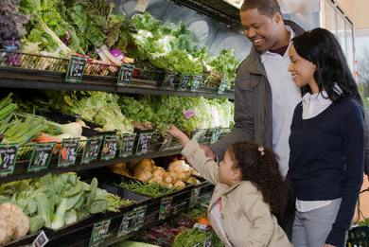

Slide 49
The 6 Language principles in two language styles
Mother 3 Mother 1
Children learn what they hear most
Children learn words for things and events that interest them
Interactive and Responsive environments build language learning
Children learn best in meaningful contexts
Children need to hear diverse examples of words and language structures
Vocabulary and grammatical development are reciprocal processes
yes no
yes maybe
yes no
yes no
yes no
yes maybe

Slide 50
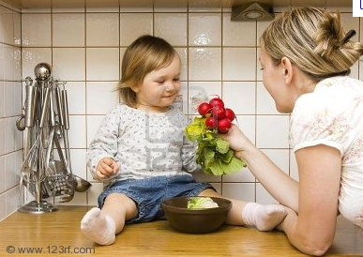
Can we train parents and teachers to be more like mother 3?

Slide 51
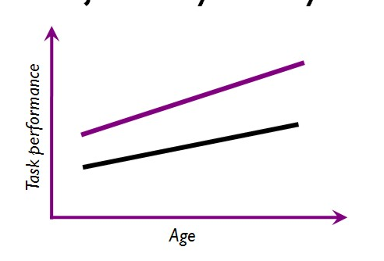
We need to systematically manipulate the 6 principles, and change language trajectories for young children by starting early
Use of 6 Principles of language
Language for reading is malleable!
(Dickinson, Hirsh-Pasek &Golinkoff (2012)

Slide 52
Some examples of curricular changes

Slide 53
We also trained parents and caregivers in our work on the California Preschool Curricula
The California Curricula
The Goal: Building language to support reading and school outcomes
The Design: Putting the 6 principles to work
An example:
Armand finds a worm on the playground and gently carries it to show the teacher. A group of excited children follow him, eager to learn more about the worm. Ms. Krim asks, “What did you find there, Armand?” as she signals to others to join the conversation. “Is it alive?” one child asks. The teacher responds, “What do you think? How could we tell?”
Principles: interest, interactive and responsive, meaning, vocabulary and grammar

Slide 54
And example of using the 6 principles in the wider community

Slide 55
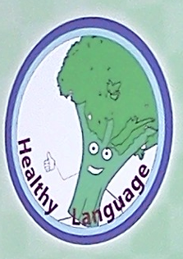
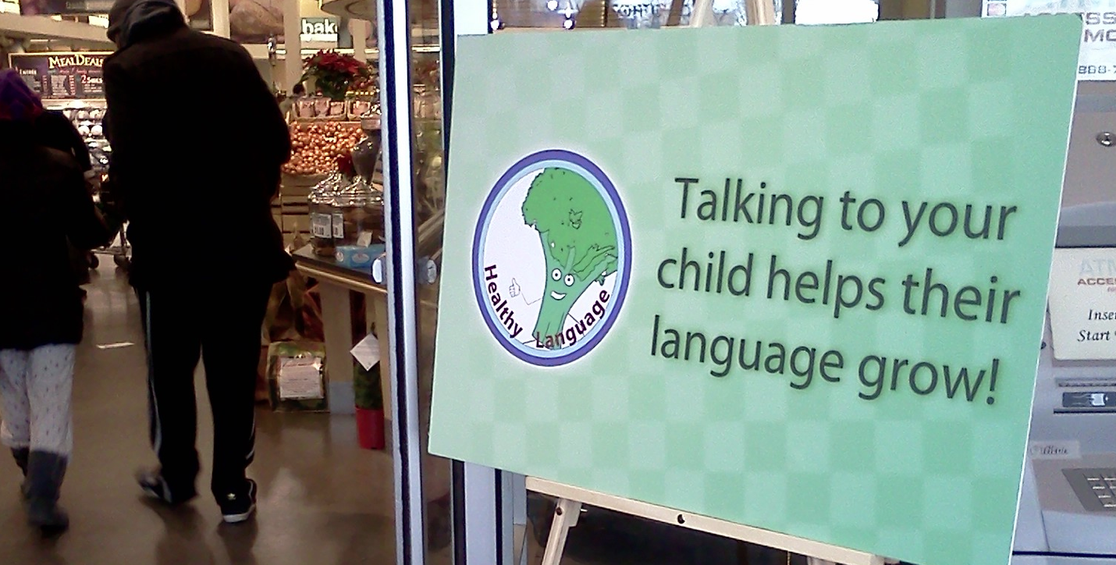
Turning supermarkets into children’s museums
In collaboration with Fresh Grocer
Ridge, Ilgaz, Weisberg, Hirsh-Pasek &Golinkoff, in progress

Slide 56
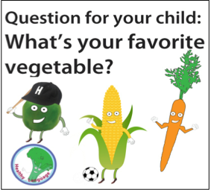
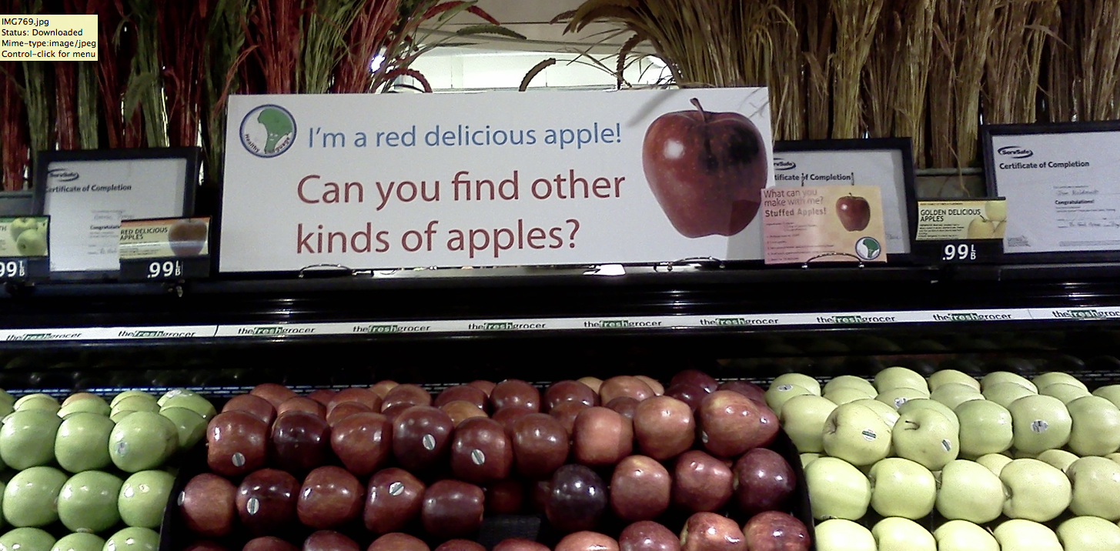
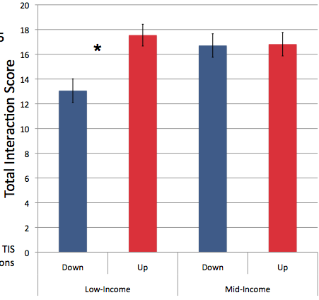
RESULTS?
In low income neighborhoods, we got a 33% increase in parent/child language when the signs were up.

Slide 57
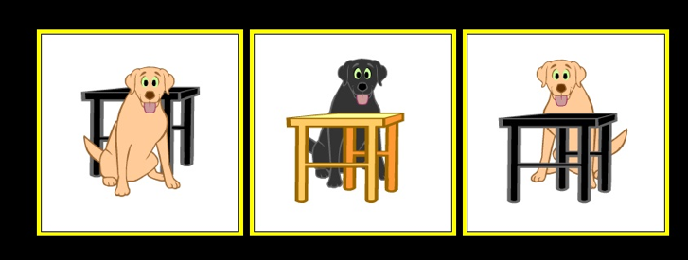
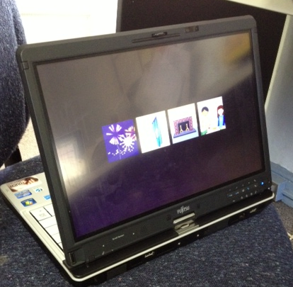
We are creating assessments to examine milestones in language growth for English and Spanish speaking children The Computer-Administered Early Language Screener (CELS)
Vocabulary | Grammar
Products
Which one is the doorknob?
Show me a dog behind a black table
Process
Can you find the blue fep?
Show me where the girl is frepping the boy.
IES grant to Golinkoff, Hirsh-Pasek, Iglesias, DeVilliers& Wilson

Slide 58
Policy implications??
Reading outcomes will not be strong unless a child’s language is strong
Start early: A large portion of North Carolina’s children are in preschool which is great, , but even 4 years of age is too late to groom great language skills
Mandate professional development to link research and practice; language to reading. So, in every document you write for early reading achievement add the word “language” when you see the word “literacy”
Demand high teacher to child rations (so that children get enough direct input)…Perhaps working with Teach for America to place more language rich teachers in preschool and elementary classrooms
Ensure high quality language in – not TV, or mere exposure to words through book reading, but meaningful social interactions with words

Slide 59
Policy implications cont??
Use a curriculum that covers broader domains (social studies and science) and that goes beyond the classroom
Ensure that teachers and parents use the curricula (assess through observation & process measures)
Think beyond the classroom: Ask how the broader community of pediatricians and business people can reinforce what goes on in school
Ensure that evidence based practice in preschool aligns with practice in higher grades. That is align the “speaking and listening” and literacy components of the Core and ask how preschool policy can feed into these benchmarks. NOTE, this does not mean merely spreading the core for K down into PreK.
Recognize that what is good for typically developing monolingual children is also good for second language learners!

Slide 60
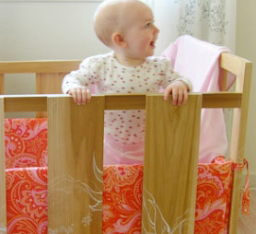
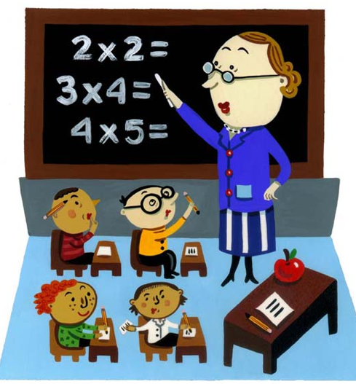
In sum…
Reading is a complex process
We know about how to support code skills and less about language to support reading
Yet those who study language development in the crib have lessons for the classroom
Six principles of language learning can help us promote strong language for reading for all children
We can put these principles into practice now and can help every child build a foundation for reading
B-O-Y

Slide 61
And thanks to NSF, IES and NIH for funding research on these issues

