Slide 1

Early Learning Communities Promising Practice for
Children and Caregivers
CDF: A Collective Action Initiative
United Way of Greater Atlanta
Atlanta, GA
Child Care Resources
Child Care Aware of Washington
Seattle/King County, WA
First Steps
Great Start Collaborative
and Grand Rapids Public Schools
Grand Rapids, MI
Smart Start Conference
May 2014

Slide 2
Early Learning Communities
It takes a village and beyond…
Parents
Grandparents
Relatives
Neighbors
Family friends
Caregivers
Child care providers
Preschool teachers

Slide 3
Meet Families Where They Are
Use Protective Factors
Parents are first teacher.
Honor the characteristics of the adult learner
Families and caregivers are supported.
Best Practice/Evidence.
We monitor, measure and report to community.
Protective factors promote optimal child development
  Knowledge of child development and parenting
  Concrete support in times of need
  Healthy social networks
  Parent resilience
  Children’s social and emotional competence

Slide 4

ATLANTA, GEORGIA

Slide 5
The Community: Norcross, GA
Norcross Parents Vision and their Design
A little school in their apartment complex
Focus on 3-4 year olds transitioning into kindergarten
Parents as volunteers and aides; prepare food
Bi-lingual lead teacher
Activities and conversations primarily in Spanish,
with a celebration of culture, developing relationships
Developmental screenings
Links to early learning center in neighborhood
Transition activities: Pre-K and school

Slide 6
Wishes Come True: La Escuelita
Funding: foundation grants, United Way of Greater Atlanta, family fundraisers child care is fiscal agent
Little Schools are located in 2 apartment complexes
One lead teacher and one parent aide for each site
Lead teachers have CDA and were Parents as Teachers families
8 to l0 children per site
9 a.m. to l2 noon at one site; l to 4 p.m. second site 4 days a week
Additional communities are interested in replication

Slide 7
What We Have Learned
Children who participate in La Escuelita have an easier transition into Pre-K and to school
Parents who participate in La Escuelita are more engaged in Pre-K and Kindergarten
Parents who participate in La Escuelita participate in leadership activities
Parents who participate in La Escuelita are more likely to stay in the community

Slide 8
“If you want to see the world, save the cost of a ticket. Come to Clarkston.”
-Basmat Ahmed
30021 Zip Code
Population just over 22,000
45% Foreign Born
40% US Born African American
13% US Born White
Median Household Income $31,197 (GA: $ 49,736)
Area was identified in 1990s for refugee resettlement
City of Clarkston
  Small town feel
  Centered around railroad
  Located just east of the intersection of I-285 and Ponce de Leon

Slide 9
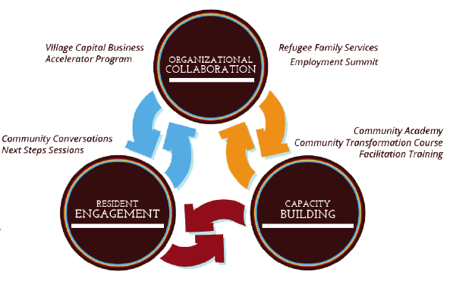
Our Work

Slide 10
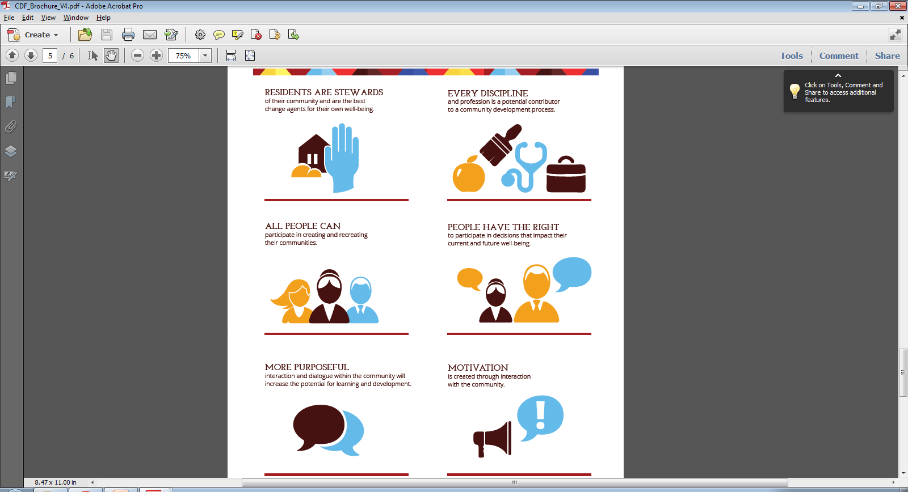
Community Engagement Fundamentals

Slide 11
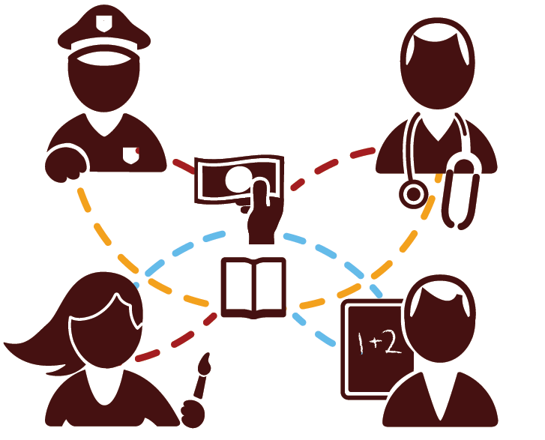
Our Process
Relationships are at the heart of everything we do. Residents connect with each other, engage with other community members and organizations, then collaborate on transformative community projects.

Slide 12
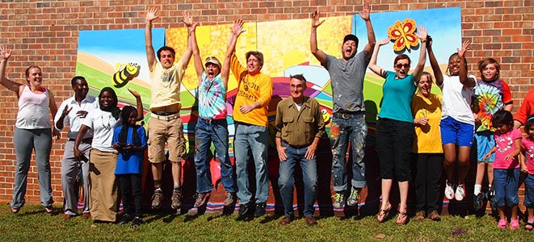
What does this look like?

Slide 13

2013 at a glance…
245
Hours of
formal training
308
People participated
in CDF hosted community meetings
73
People attended
CDF workshops
15
Entrepreneurs introduced to mentors, business concepts and local networks
11
Community grant applications supported
10
Languages spoken at Trust Meeting
54
Formal engagements with the community
6%
Economic Development
41%
Education
9%
Safety
40%
Other Areas
4%
Health

Slide 14
W.K. Kellogg Foundation Parent Engagement Award:
Clarkston Families Decide
Parent leadership workshops – multiple languages
A participatory decision-making process: Community Trust
School transition/school-family partnerships
Advisory Committee
City of Clarkston leadership
Participatory evaluation

Slide 15

Seattle/King County
Washington
Notes:
19 school districts

Slide 16
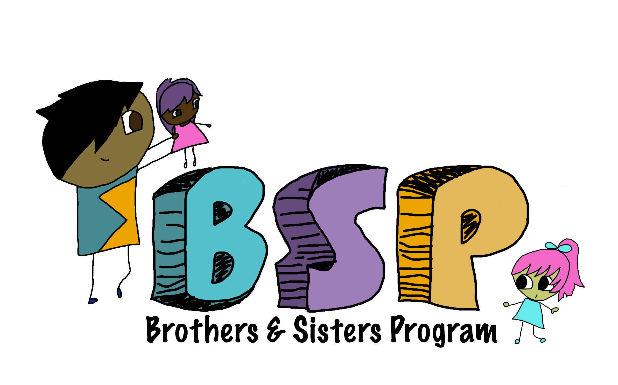



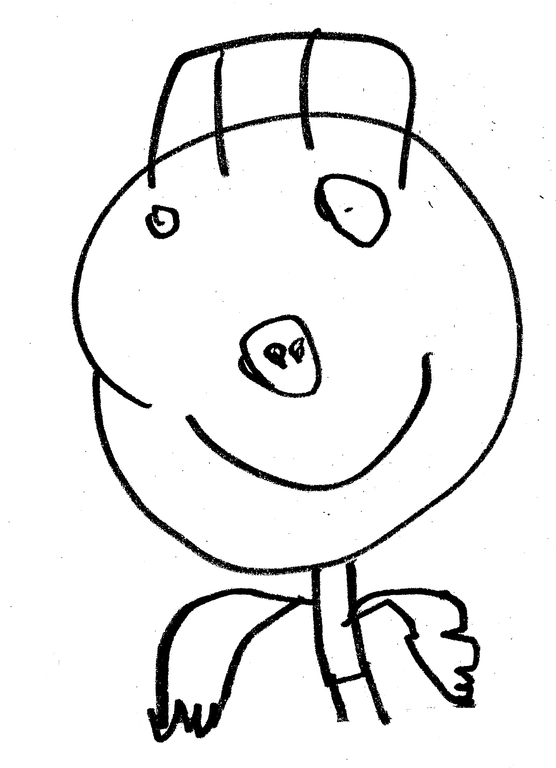

Community-based programs
in Washington State
Developed by Child Care Resources
and Child Care Aware of Washington
Taking Care of Our Children:
Conversations for the Community
Notes:
All the programs we have developed share common goals:
to increase adult knowledge about child development, understanding of children’s behavior, and skills to support early learning
to develop and support positive social networks
to provide parents and caregivers with leadership and growth opportunities that increase self-efficacy
to be a gateway to information, services & resources
Strength-based messages delivered through coaching, modeling, peer conversations, referrals, shared resources, materials, and “training.”

Slide 17
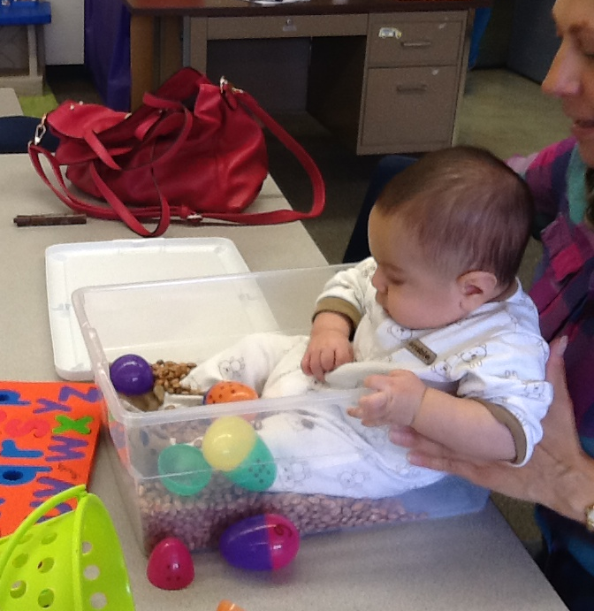
Kaleidoscope Play & Learn
Facilitated play groups for children and their caregivers where adults learn how to support healthy child development through play and interaction.
Trained facilitators intentionally create opportunities for:
Parent/caregiver leadership
Parents and caregivers to interact
and to build supportive
relationships with each other
Adult learning through instruction
and role modeling
Identifying teachable moments at home
In 2013 Kaleidoscope Play & Learn was recognized as a Promising Practice by the Evidence Based Practice Institute at the University of Washington.
Notes:
All Kaleidoscope facilitators participate in a 2-day facilitator training and quarterly continuing education.
Groups are hosted by community based organizations such as family centers, libraries, immigrant/refugee serving agencies, elementary schools, Family Support Centers, shopping malls, apartment complexes, Public and private housing, churches
Where people Pay, Pray, and Play…and Live

Slide 18
Essential Elements of
Kaleidoscope Play & Learn
Multicultural facilitators support home culture and language
Hosted in neighborhood locations: family centers, libraries, schools, apartment complexes, churches, public housing, even shopping malls
Community resource information and referrals are available for participants
Groups meet weekly for 90 minutes or more and include
  Open-ended, child-directed “free” play
  Coordinated group activity
  Focus on positive adult-child interaction
  Fun http://youtube.com/watch?v=56YvMg8uGhs
Notes:
Children and adults participate together in developmentally appropriate activities
Children and adults interact with each other, and with other participants

Slide 19
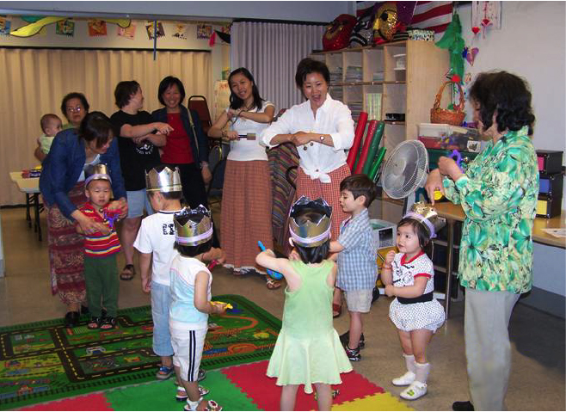
Notes:
Chinese Information and Service Center – many grandmothers attend this group

Slide 20
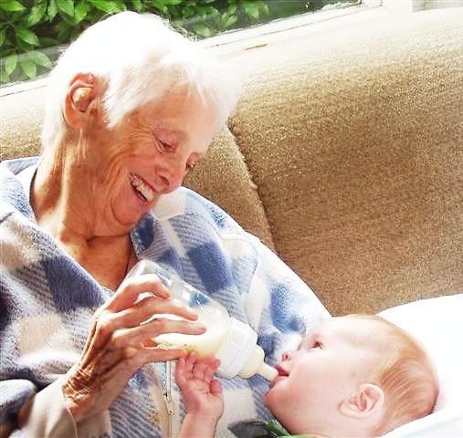
Early Learning Conversations
Conversations present information about healthy child development and school readiness in a format combining dialogue and hands-on activities led by peer educators. The peer educators receive training and support on conversations content and facilitating learning discussions.
Peer educators include: parents, caregivers,
promotores, family liaisons and ambassadors
working in elementary schools, community
home visitors, Kaleidoscope Play & Learn
Facilitators.
Conversation circles include anybody caring
for a child birth-5: parents, grandparents,
aunts & uncles, other extended family, kinship caregivers, foster parents.
Notes:
Developed in response to community members who experience barriers to accessing culturally relevant early learning information and supports.

Slide 21
Brothers & Sisters Program
Developed to support the increasing number of youth who care for their younger siblings before and after school, BSP is an 8-week afterschool workshop where youth gain the knowledge, skills, confidence and resources they need to provide a safe, nurturing environment that supports healthy child development – for themselves and their siblings.
  Child Development and Behavior Management
  Self Care for Youth
  Home Safety and Safe Play
  Adult/Child First Aid and CPR
  Career pathways in Early Childhood Education
Notes:
Tukwila School District, which is extremely diverse, is considering a later start time for middle and high school because of the number of students who arrive late after getting their younger siblings off to elementary school every morning.

Slide 22
WaKIDS
Washington Kindergarten Inventory of Developing Skills
Engaging Washington State in a conversation about the characteristics of children’s development and learning that will enable them to be successful in school. WaKIDS has three components:
FAMILY CONNECTION
Teachers welcome families and students to school individually as partners in their children’s education.
“WHOLE CHILD” ASSESSMENT
Teaching Strategies Gold measures six areas of development and learning.
EARLY LEARNING COLLABORATION
Kindergarten teachers and early learning professionals share information and expertise
Notes:
Teaching Strategies Gold is an observational whole-child assessment administered by Kindergarten teachers in fall. This provides valuable information on students’ physical, cognitive, social/emotional, language, literacy and mathematics development so teachers may tailor their instruction to individual needs.

Slide 23
Alignment with WaKIDS
Family Connection and Early Learning Collaboration
Child Care Resources’ programs and messages
Are culturally responsive, respectful and strength-based
Approach parents as partners in supporting child development
Increase access to early learning information and supports
Support early family engagement in children’s education
Provide opportunities that help parents develop relationships with schools during their child’s preschool years
Inform families about school readiness and expectations for children entering Kindergarten
CCA of WA supports Early Learning Coalitions and Collective Action
Connect principals with early learning professionals
Advocates for inclusion of family perspectives and needs in planning, policies and practices
Shares data and promising practices
Notes:
More than 50% of children ages birth-5 are cared for by family members – “family, friends & neighbors.”
We are working at local, regional and state levels within Coalitions and Collective Action to ensure these children and their families are included in the early learning system. The issue is equitable access to culturally responsive early learning programs and supports.

Slide 24
Impact
Kaleidoscope Play & Learn
  3500 families attending annually across the state
  63% identify as people of color
  44% speak a language other than English at home
  44% are living below 200% of the national poverty level
Early Learning Conversations
  Parent/caregiver leaders and promotores leading discussion groups
  for parents and caregivers in culturally diverse communities across
  King County
Brothers & Sisters Program
  70 high-school aged youth from immigrant and refugee communities have attended
  One 16-year old youth shared: “Now I am not afraid to stay home
  with my little brother.” His brother is 2 years old.

Slide 25
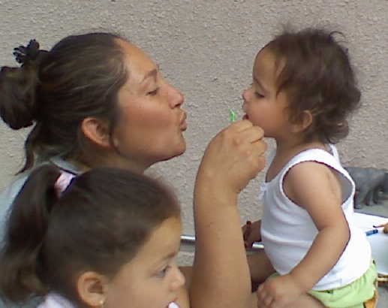
Outcomes
Kaleidoscope Play & Learn
Stronger social networks
Increased knowledge about how
children learn through play
Increased adult/child interactions
  Talking with children about their feelings
  Reading together
Early Learning Conversations
Process and outcome evaluation currently in design/pilot phase
Brothers & Sisters Program
90% of youth participants said they know “a lot” about how young children develop, compared to 20% before attending

Slide 26

Grand Rapids, Michigan

Slide 27
Early Learning Communities
Program Goals
Positively impact the learning and social development of young children
Improve interactions of caregivers with young children
Increase exposure to literacy activities in the home environment
Increase access to community resources for caregivers and children
Increase identification of children with developmental delays and
referrals for early intervention
Build relationships between children, families and private childcare
centers in their neighborhood school prior to kindergarten entry
Assist with the transition to Preschool and Kindergarten for families
and children

Slide 28
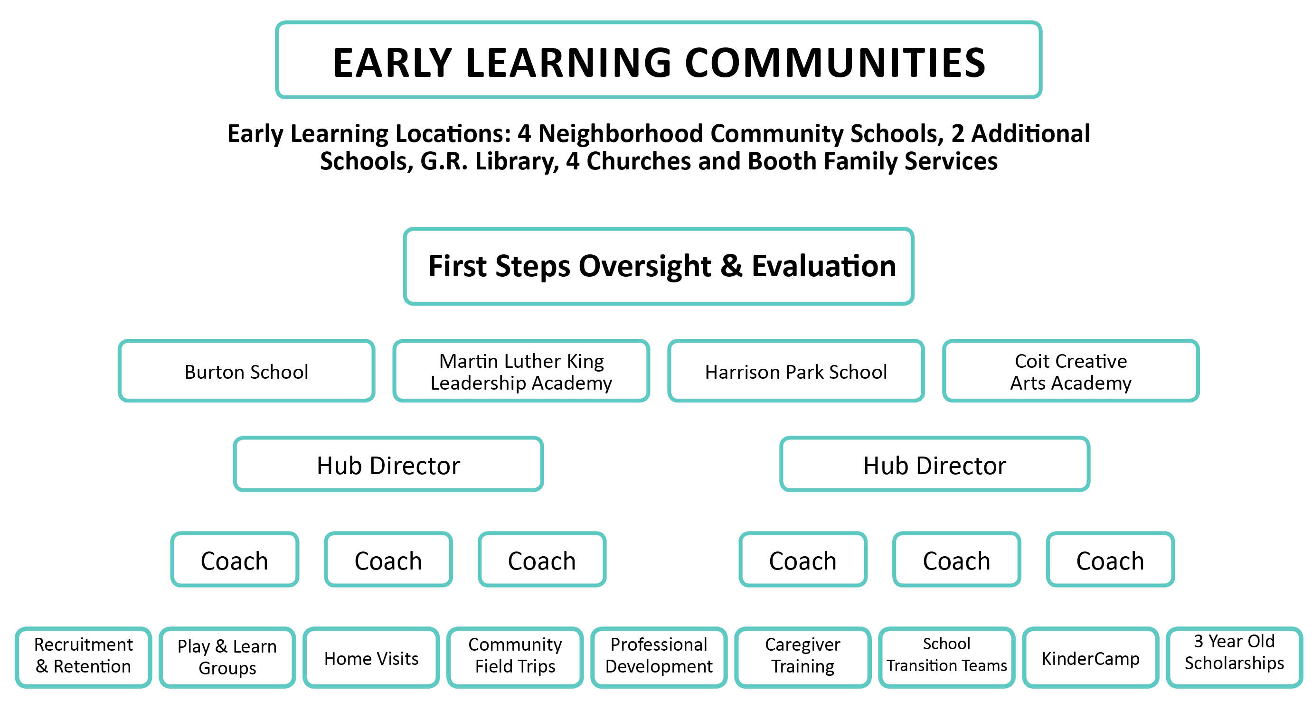

Slide 29
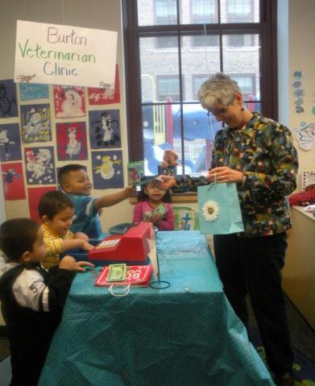
Play and Learn
Learning Station with activities
linked to MDE learning standards
Essential learning for adults
certified for provider training
Highly qualified staff
Pre and post child skill assessment
Child and family goals
90 minutes with whole group
literacy/story instruction
9 groups per week in Grand
Rapids Public Schools
Activity bags to go home to
connect to extended learning at home

Slide 30
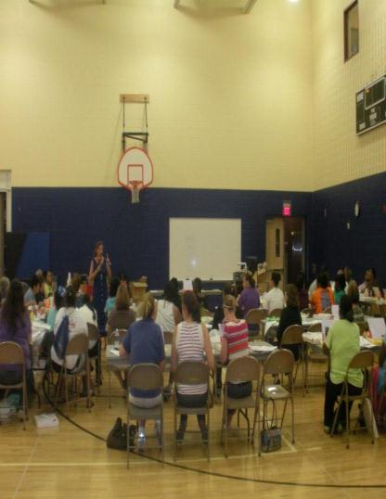
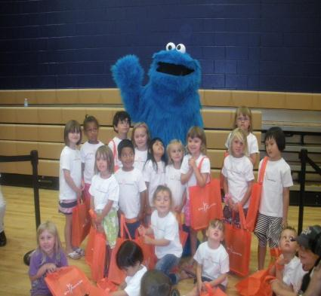
Training for Caregivers
Family Field Trips
Plan with school teams to include: a strong literacy focus, cultural responsiveness, pre-writing, inclusive options. Use the school neighborhood to show families the wide array of resources available to support them

Slide 31
Early Learning Communities identifies
children and caregivers around each school.
2013 at a glance…
414
Play and Learn Groups held
87%
of caregivers have
increased reading
at home
934
Caregivers/teachers
attended training
4
School transition teams
have developed their
own outreach and
planning
43
Families attended
KinderCamp
75%
of 3 year old preschool scholarship children met or exceeded developmental benchmarks at end
of 4 year old year.
Awareness grows as new state allocations have greatly increased capacity for 4 year old preschool.

Slide 32

A community system to align, coordinate and provide triage to necessary services
Preschool Scholarships and KinderCamp
http://youtu.be/mQzGh4OL_lg

Slide 33
Parent Institute at KinderCamp
A Model for Family Engagement
Getting on the school platform
Coffee – “Pete the Cat – Rocking in My School Shoes”
Meet the Principal and School Secretary
What to expect the first day of school
Attendance – Tardiness - Uniforms
Sleep Routines-School culture and events
School year calendar-School newsletters, website,
P.B.I.S. – Positive Behavior Implementation System
How to communicate with the school
K Curriculum, Progress Reports and Assessments
Meet the P.T.A.-school involvement and volunteering
Make a white board monthly calendar

Slide 34
How to Help Your Child Achieve
Research on Parent Involvement
Meet your community school staff, family support specialist
and DHS and learn about the services available
What’s in your child’s record – review a cumulative record folder
How to have a successful Parent-Teacher Conference
Accessing your child’s records
Practice school work at home and have child work
towards independence
How to encourage your child
Organization at home
Talent and Achievement Portfolios – complete assembly and discuss

Slide 35
ELC Results
63% of children assessed were in the low-average to extremely
low-average range at pre-test
Children with pre/post assessment demonstrated a positive program impact
The impact to improve oral language for “at risk” children was high (PPVT)
Children demonstrated gains in number of letters recognized (PALS)
A large caregiver market in the identified neighborhoods was involved
This program has become a quality early learning option for the school district it serves. Provides parent training and increased involvement
“JUMP START” the multi-year evaluation summary is available as a handout

Slide 36
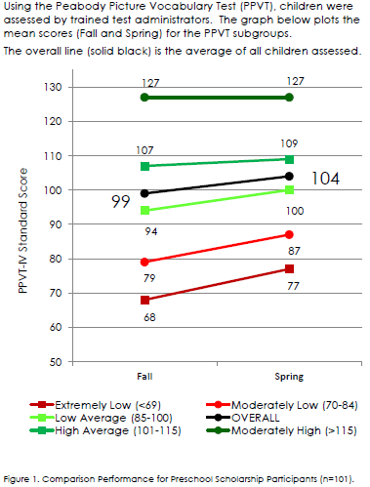
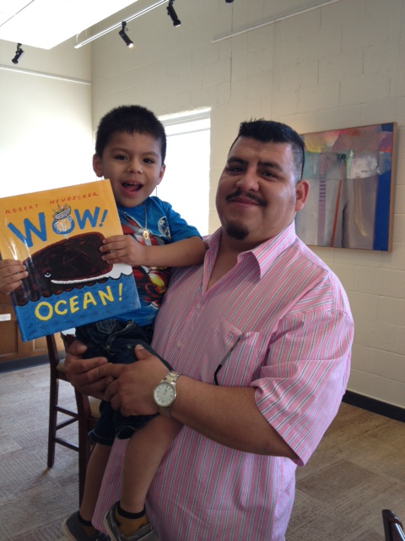
Preschool Scholarship Program
“We’d like to see Andres go to college; we want him to have choices when he grows up. Maybe he’ll become a doctor instead
of working in a factory.”

Slide 37
Innovations Taking Hold
Early Learning Communities results in:
Parent driven programming where parents are engaged in design of
early learning collaborations
Community based programming in the neighborhoods where service
is needed
Informal learning environments
Integration into school systems
Transition to School with parents as partners
Weaving the family connection into Kindergarten entry assessments
Responsiveness to language and culture
Development of skills for the caregivers and children who participate
while growing the learning at home with parents as teachers

Slide 38
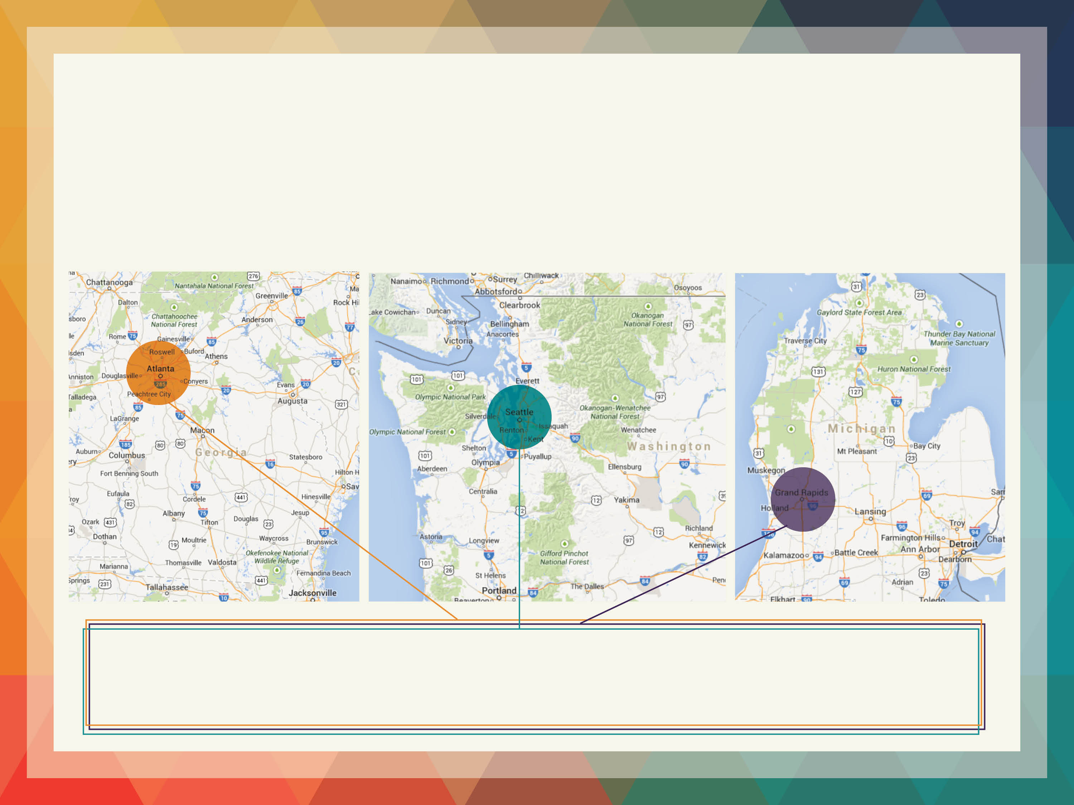
Three Communities… One Goal
Every young child will enter kindergarten
ready to succeed in school and in life.

Slide 39
What’s Next…
Roberta Malavenda
404-317-2734
roberta@cdfaction.org
United Way of Greater Atlanta: www.cdfaction.org
Paula Steinke
206-329-1011 x9236
steinke@childcare.org
Child Care Resources: www.childcare.org
Judy Freeman
616-632-1019
jfreeman@firststepskent.org
First Steps: www.firststepskent.org

